Slide 1
Transparency in value
HealthTechNet
01/21/22

Slide 2
Value Analytics: Operational Synergy to Excel at Defining and Delivering Value
Risk Adjustment
Quality
Identify appropriate complexity and risk to budget effectively
Plan, operate, and reimburse across a spectrum of APMs
Tie APM performance to quality
Adjust for new performance year based on updated data
Leverage standards for consistency in scale
Alternative Payment Models
Ingest Data Once, Generate Multiple Insights
NFM MBR December 2021
Now Speaking:
Summer Kahlon

Slide 3
Episode Of Care Definition Fundamentals
Value-based mode designed to engage specialists
Full spectrum of services related to and delivered for a specific medical condition, illness, procedure or health care event during a defined time period
Coordination, communication, collaboration across the continuum of care
Episode Example: Procedural Episode
Pre-Trigger Services
(e.g. Labs, X-Rays)
Trigger
(e.g. Surgery)
Post-Trigger Services
(e.g. SNF, LTAC, PT)
Configurable period of time prior to the triggering event.
Configurable period of time post the triggering event.
The specific diagnosis and/or confirming claims that start the creation of an episode
Analysis Across The Continuum Identifies Opportunities For:
Cost Savings
Quality Improvement
Network Optimization

Slide 5
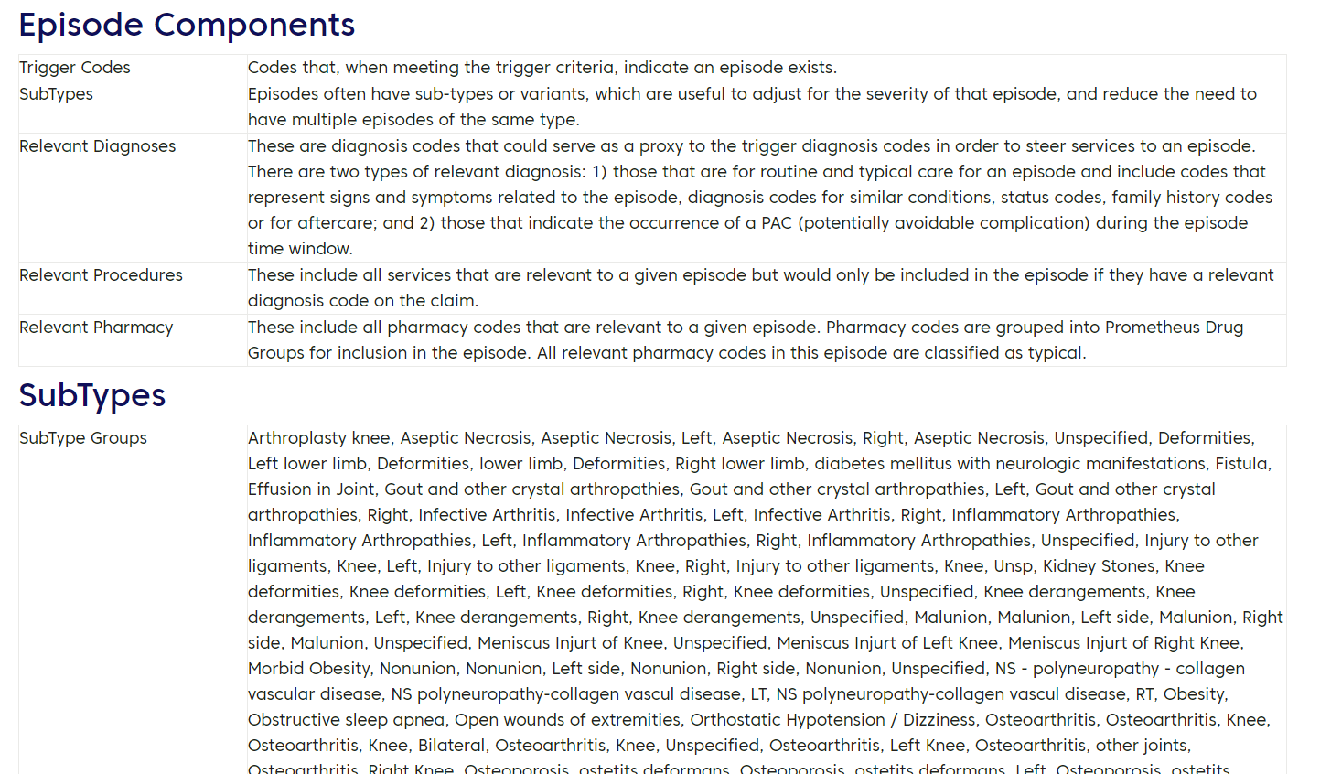
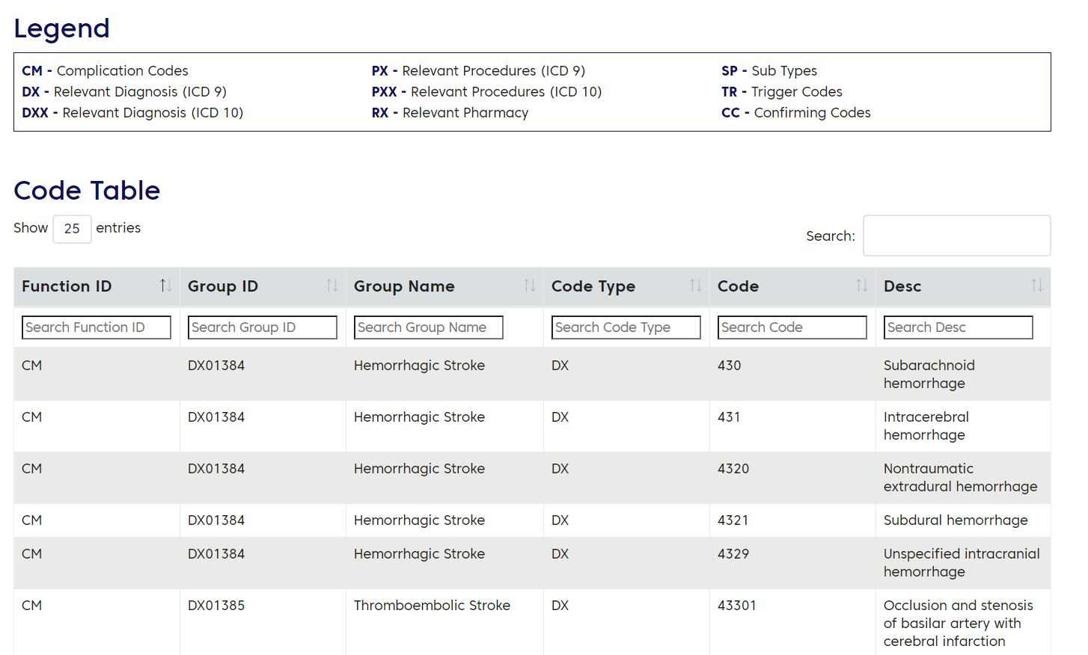
Prometheus: Infrastructure to Define Episodes of Care Publicly Accessible Definitions, Parameters, Code Sets, and Potentially Avoidable Complications (PACs)
97 Episodes of Care: Procedures, Chronic, & Acute
Approx. 100 million covered lives including Commercial and Medicaid (plans and states) ¹
Approx. $1 trillion in claims analyzed annually ²
¹ Based on customer information and feedback. ² Internal Change Healthcare data based on volume of claims using Prometheus Analytics.

Slide 6
A Transparent, Collaborative Approach to Content
Advisory Board
?
Vendors
Clinicians
Proprietary
“Black Box”
Prometheus
“Transparent Box”
Transparency: Open Access
Payers and state agencies can review content and configure standard analytics to match program needs
Providers can review vetted, trusted content
Website maintained so all licensed users can access and search definitions, parameters, and code sets within the EOC grouper
Collaboration: Governance Board
Industry-driven collaboration prioritizes needs
Cross-section of payer, provider, SME, and government
Broad group of outside clinicians for peer review of content
Technology firms licensing Prometheus influence development to ensure scalability and reproducibility

Slide 7
PROMETHEUS Cost Analysis
Total Cost of Care
All Costs Relevant to Episodes
Costs Not Assigned to Episodes
Costs of all Typical Care
(Provider Practice Patterns)
Costs of all Potentially Avoidable Complications
Core Services
Other Relevant Services
All Costs Adjusted for Severity & Comorbidities
Overused Services
Routine Services

Slide 8
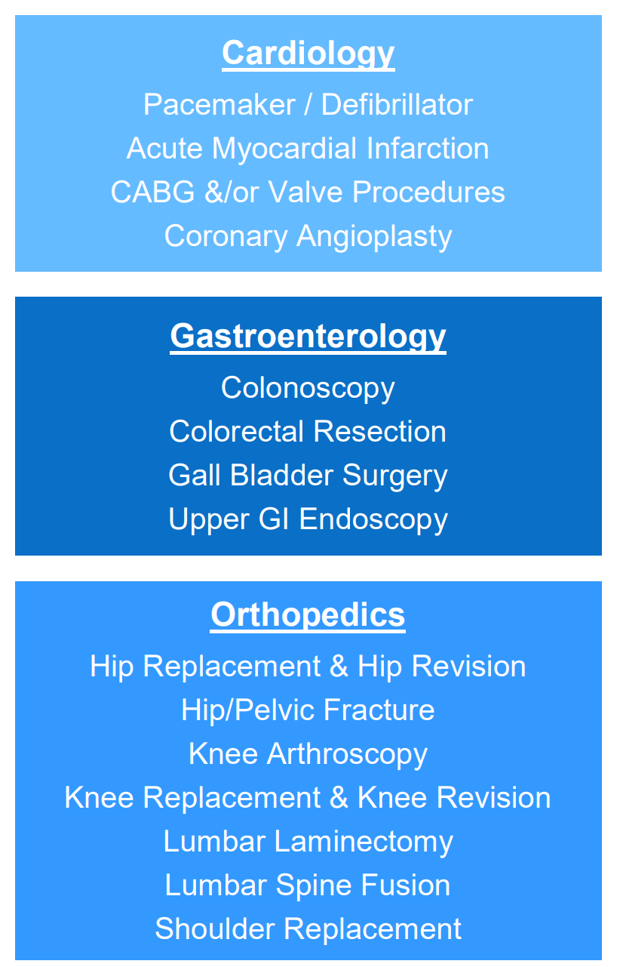
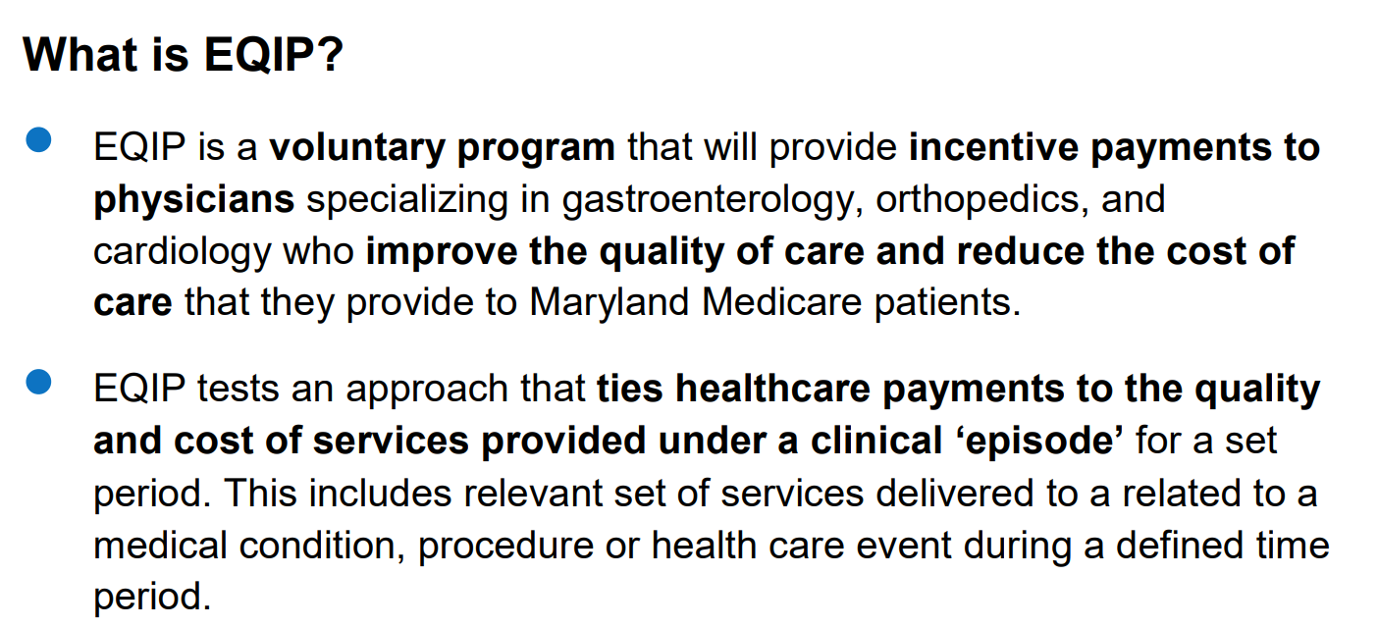
Use Case: Maryland HSCRC EQIP Program Leveraging Prometheus
https://hscrc.maryland.gov/Documents/OVERVIEW%20FLIER.pdf

